Slide 1
BEYOND THE TERRARIUM?
EINAR W. HØST
Notes:
Hi,
I usually say thank you for coming to my talk, but I guess you didn't have much choice. So I'll just say good afternoon.
My name is Einar Høst and I've been to Booster always. I was at Booster before it was Booster. I'm not joking. I did my first lightning talk at the ROOTS 2012 conference and I’ve been here ever since. So you can imagine it's quite the honor for me to be here on stage to do the closing keynote.
What should we talk about today? I usually talk about whatever’s at the top of my mind with respect to software development, and I’m going to do the same thing today. It’s usually something that’s been bothering me for a while, that I haven’t been completely able to put my finger on, and that I haven’t articulated. Making a talk helps me articulate what it is.
It’s like discovering that you have a pebble in your shoe.
People call you negative when you're like that, but I like to think of myself as positive, because I have this idea that we can do better. Real negativity is looking at the current state of affairs and going, yup, that's as good as it's going to get. That’s my perspective anyway.
So what is it?

Slide 2
HOW WE DO SOFTWARE
Notes:
Well. I want to talk about how we do software development today, how it got that way, whether or not we’re happy with that, and since obviously I’m not, what we do better.
and in particular how software development is integrated in organizations?

Slide 3
NARRATIVE AND REALITY
Notes:
In the course of that, I want to talk about what you could call narrative and reality. Reality is reality, but narrative is about the stories we tell, how we describe reality which may or may not be very accurate.

Slide 4
AGILE?
Notes:
We can’t really talk about how we do software today without talking about agile.
Who here does some sort of Agile software development? Yeah. Agile won. But it won a long time ago.

Slide 5
WHAT HATH AGILE WROUGHT?
Notes:
In a sense what triggered the thinking that lead to this talk, is a reflection over this. What has agile brought to the world? Sort of what is the legacy of agile.

Slide 6
AGILITY?
Notes:
An interesting question might be if it has brought us agility? But it’s hard to answer that question in any meaningful way without being much more specific. Agility in what sense? What kind of agility? Agiltity for whom, to do what?

Slide 7

Notes:
So when I thought for a while about what Agile has brought to the world, the image that emerged in my head was this.
What is it? It’s a terrarium. A terrarium is an artifical habitat for plants or insects or spiders or something like that.

Slide 8
THE TERRARIUM MODEL OF SOFTWARE DEVELOPMENT
Notes:
The idea is to create a "productive terrarium" for software development, "sheltering the team" from the environment, trying to control and optimize the conditions inside the terrarium, avoiding too much and too little of anything (causes laziness and demotivation, respectively), asking if the busy silkworms are feeling safe and thriving, while applying a mild pressure to produce, perhaps a little faster, a little more this iteration. Have you set your stretch goals? Because we need that silk.

Slide 9
IS THE TERRARIUM AN APT METAPHOR?
Notes:
So I have a couple of questions that I’d like you to ponder and make up your own mind about. The first is this. Is the terrarium an apt metaphor for software development today? Are we busy little silkworms in a glass box?

Slide 10
IS THE TERRARIUM AS GOOD AS IT GETS?
Notes:
And the second question is this. Is the terrarium as good as it gets for software development? Do we have any alternatives?
I’m not going to answer those questions for you. But I think that the terrarium is real, in the sense that it captures something important about how we do software today. I also think it has some downsides that we need to be aware of.

Slide 11
AGENDA
Notes:
So a short agenda for this talk

Slide 12
ORIGINS OF THE TERRARIUM
Notes:
First we’ll take a look at where this terrarium model came from.

Slide 13
RELATIONSHIP WITH AGILE
Notes:
We’ll discuss the relationship with agile.

Slide 14
PROS & CONS
Notes:
Then we’ll look closer at the consequences of the terrarium model, the pros and cons. How is it useful, and what shortcomings does it have.

Slide 15
GOING BEYOND
Notes:
And then finally we’ll discuss what it would take to go beyond the terrarium model, should we see the need for that.

Slide 16
HOW DID WE GET HERE?
Notes:
But OK, if we do software development in a terrarium today, how did we end up there?

Slide 17
HISTORY TIME!
Notes:
It’s history time! I’m sorry, but I’m an older guy now, I’ve been in this industry for more that twenty years. After a while, it’s inevitable that you start drawing these lines. It’s going to happen to you to.

Slide 18
1990+
Notes:
So I want to go back to the 1990s. This was the decade of software engineering, software architecture and heavy-handed processes.

Slide 19

THE AGILE REVOLUTION
Notes:
And then of course Agile happened, which basically killed off the term software engineering, threw down the architects from their towers and so on and so forth.
As a meme and metaphor, Agile has been tremendously successful.

Slide 20
Individuals and interactions over processes and tools Working software over comprehensive documentation Customer collaboration over contract negotiation Responding to change over following a plan
Notes:
So in February 2001, we got this thing. This is often called the Agile manifesto, but it’s really the manifesto for Agile software development. And as you can imagine, all the things in white were things that were very important in the 90s.

Slide 21
12 principles of agile software
Notes:
We also got 12 principles of Agile software, that sort of power the manifesto. I’m not going to mention all of them, but I’d like to highlight a few that I think are relevant for our discussion of the terrarium model of software development.

Slide 22
Business people and developers must work together daily throughout the project
Notes:
The first is this. Business people and developers must work together daily throughout the project. Daily! That’s pretty often.

Slide 23
The most efficient and effective method of conveying information to and within a development team is face-to-face conversation
Notes:
The second is this.
The most efficient and effective method of conveying information to and within a development team is face-to-face conversation.

Slide 24
At regular intervals the team reflects on how to become more effective then tunes and adjusts its behavior accordingly
Notes:
And then finally this. This is about retrospectives and continuous improvement.

Slide 25
Notes:
OK, so, that’s a lot of ideas and ideals and good intentions. So when the smoke settled, where were we?

Slide 26

SCRUM + JIRA
Notes:
Well we ended up here, didn’t we. Out of the smoke we emerged with Scrum and Jira. Who here uses Jira? What about Scrum?

Slide 27
A PROCESS AND A TOOL?
Notes:
So, all that talk, and we got a process and a tool.

Slide 28
Individuals and interactions over processes and tools?
Notes:
This is literally the first sentence of the manifesto. But OK.

Slide 29
SCRUM
Notes:
I want to talk a little bit more about Scrum. Scrum is very important to this story. Scrum very early on emerged as the winner of the competition between various attempts at creating a light-weight process for software teams.

Slide 30
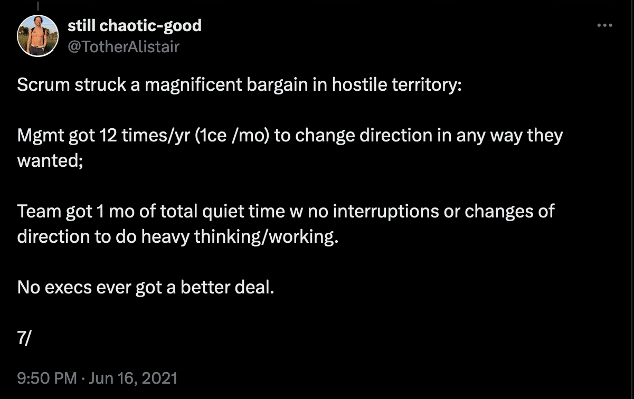
Notes:
I wasn't aware of this until last fall, but apparently Scrum very deliberately set out to make a deal in a hostile environment. I came across an old thread by Alistair Cockburn. The most startling post in that thread was this.
Scrum struck a magnificent bargain in hostile territory: Mgmt got 12 times/yr (1ce /mo) to change direction in any way they wanted; Team got 1 mo of total quiet time w no interruptions or changes of direction to do heavy thinking/working.
If you're not familiar with Alistair Cockburn he is one of the important Agile pioneers, one of the original co-signers of the Agile manifesto, and more recently known for the concept of hexagonal architecture or ports & adapters.

Slide 31

THE SCRUM PACT
Notes:
So what really happened was this. Scrum was invented to function in hostile environments, it's a really interesting contract between hard-pushing execs and devs needing time to think.

Slide 32
THIS IS THE TERRARIUM MODEL
Notes:
This is very important for this talk, because what the Scrum pact sets up is the terrarium model.

Slide 33
Notes:
So we have two sides.

Slide 34
WILL PRODUCE SILK FOR PROTECTION
FEATURES
Notes:
One that offers to produce features for protection.

Slide 35
WILL PRODUCE SILK FOR PROTECTION
WILL OFFER PROTECTION FOR SILK
FEATURES
FEATURES
*
Notes:
And another that offers protection in return for features. There’s an asterix there. Some conditions apply. The team also needs to follow certain practices and rituals, for instance as dictated by Scrum.
There’s a guy called Brian Marick, another one of the OG agile folks, who has a podcast called Oddly Influenced, and in one of the episodes he discusses this kind of gift exchange between the development team and management. One thing I think is very interesting is if and how the accumulation of technical debt threatens the balance in this exchange. In a sense, it gets harder and harder to produce silk. And what happens to the protection then.

Slide 36
THAT WAS 20 YEARS AGO
Notes:
That was twenty years ago.

Slide 37
AND THEN... NOTHING?
Notes:
What has happened since? I mean, I’m claiming that we’re still working inside this terrarium.

Slide 38
NOT QUITE
Notes:
It’s not true that nothing has happened. Quite a lot has happened.

Slide 39
AGILE SCOPE CREEP
Notes:
First of all, we’ve seen quite a bit of scope creep for Agile.

Slide 40
AGILE SOFTWARE DEVELOPMENT
Notes:
We started out with agile software development.

Slide 41
AGILE PRODUCT DEVELOPMENT
Notes:
That has turned into a focus on agile product development.

Slide 42
AGILE ORGANIZATIONS
Notes:
And perhaps even agile organizations.

Slide 43
AGILE BUSINESS
Notes:
Because we want to do agile business.

Slide 44
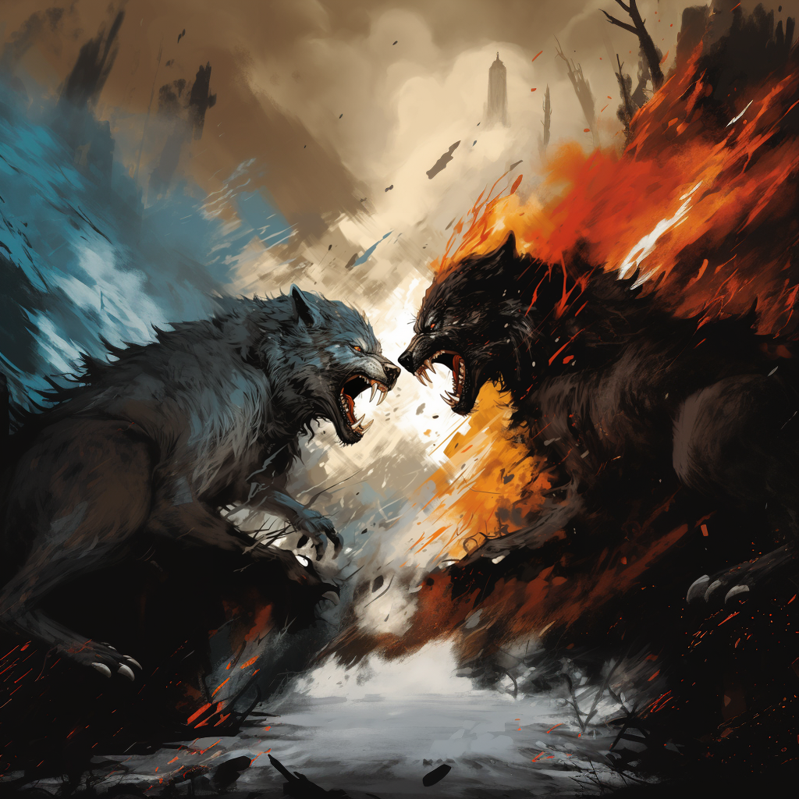
A TALE OF TWO AGILES
Notes:
The other thing that’s happened I think, is that Agile very quickly split in two. To me, Agile was in a sense about bringing business and IT together to create value, but that unification didn’t last very long. Alistair Cockburn has this notion of “The Heart of Agile”, and I have this image in my head of two wolves ripping that heart apart and taking a part each to chew on in peace. If you look at the world of conferences, for instance, you have developer conferences and you have agile conferences, and there’s not too much overlap in the attendees.

Slide 45
”TECHNICAL AGILE”
Notes:
So on one hand we got “technical Agile”.

Slide 46
DEVOPS
Notes:
And quite a lot has changed over the last twenty years. We’ve seen the movement to the cloud, and a lot of things that falls under the umbrella of devops – more focus on teams taking ownership of the running application, service level objectives, observability, automated build pipelines, continuous integration, continuous delivery, and so on and so forth. There are also practices such as mob programming and trunk-based development. These all contribute to a sort of agility. We can change the software much more quickly and reliably than we could before.

Slide 47
”BUSINESS AGILE”
Notes:
On the other hand, we have what we could call “business Agile” which is about Agile bureaucracy in a sense. How do you manage your Agile teams. How do you get productive teams? How do you ensure alignment. xsRefining the set of practices and rituals carried out under the Scrum pact.

Slide 48
AN ENDLESS STREAM OF SILICON VALLEY SELF-HELP BOOKS PUSHING THE AGILE FRONTIER
Notes:
We’ve had an endless stream of good advice coming out of Silicon Valley, where the winners have written up their recipes to be followed, confirmation bias be damned.

Slide 49

RADICAL PIXIE DUST
Notes:
They’re all selling various forms of radical pixie dust to sprinkle on top of your ongoing agile transformation, in hopes of fulfilling the agile dream.
If I’m sounding a little bit cynical it’s because there’s very little science in this.

Slide 50
HAS IT WORKED?
Notes:
Has it worked?

Slide 51
WE’VE TRIED
Notes:
I dunno. We’ve certainly tried.

Slide 52
EVERYTHING IS A SUCCESS UNTIL IT IS ABANDONED
Notes:
It’s hard to talk about this, because everything is a success until it is abandoned.
Who here does planning poker? I had an idea for a lightning talk about planning poker once, but then planning poker disappeared from my life, and so there was no point in doing the talk.
If you talk to teams implementing OKRs today if they’re working well, you might get enthusiastic response. If you ask them in three years if they’re still doing OKRs? We’ll see.

Slide 53
VERY LITTLE STICKS
Notes:
Not everything sticks. Perhaps even very little.

Slide 54
THINGS HAVE GOTTEN WEIRD
Notes:
For that reason, things have gotten a bit weird.

Slide 55
THE IDEALS HAVE EVOLVED
Notes:
The ideals for teams have evolved greatly.

Slide 56
BRIDGING THE GAP

Slide 57
CUSTOMER OBSESSION

Slide 58
SEAT AT THE TABLE

Slide 59
REALITY IS LARGELY THE SAME
Notes:
Whereas it seems to me that the reality is still largely the same. It’s still largely the Scrum pact.

Slide 60
THE TERRARIUM MODEL
Notes:
And the reality is still that development happens in a productive terrarium.

Slide 61
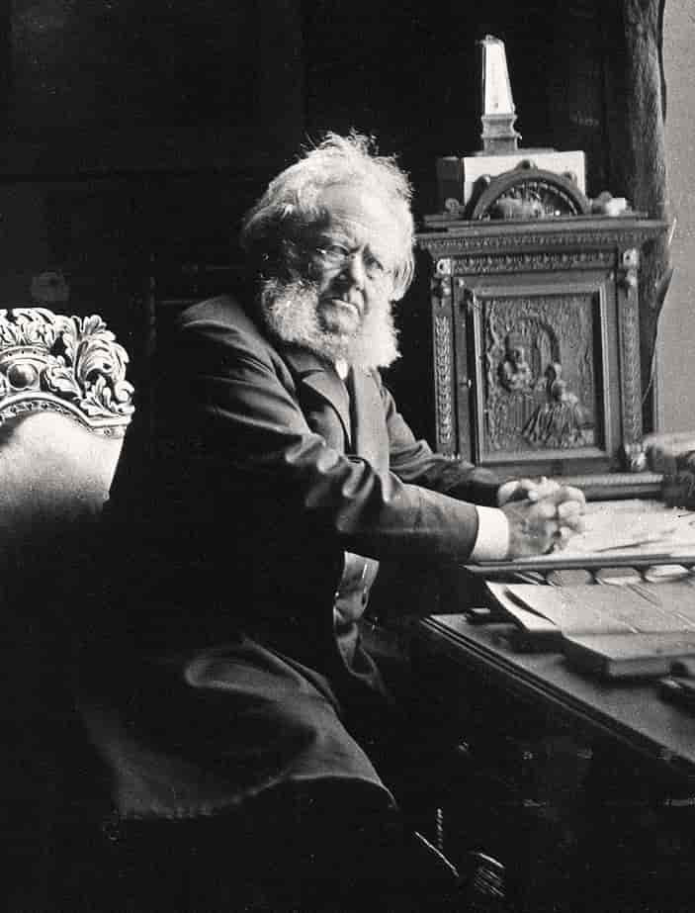
don't use that foreign word ideals We have the excellent native word lies
THE AGILE LIE

Slide 62
DIRTY SECRET?

Slide 63
IS THE TERRARIUM SO BAD?
Notes:
It’s time to talk about the pros and cons.

Slide 64
STRENGTHS

Slide 65
PROTECTION
Notes:
For the people inside the terrarium, it offers protection from interruptions, politics, responsibility.
For the people on the outside, it offers protection from technology. It encapsulates all that.

Slide 66
COMFORT
Notes:
It also offers comfort. Life inside the terrarium is pretty comfortable. It’s a good life. Silk worms feed on bamboo leaves, developers feed on Jira tickets.
Your job is to do the work. Someone else can handle the risk and negotiations and interactions with people who don’t get tech.
If we stray from the agile ideals, it’s because management won’t let us follow them. If anything goes wrong, it’s due to things that happen outside of the terrarium.

Slide 67
UNDERSTANDABLE
Notes:
It’s also very understandable. Software happens inside the terrarium, strategy and business on the outside.

Slide 68
WEAKNESSES
Notes:
The main problem with the terrarium is also the foundation of its strength – the isolation. It’s the terrarium wall that gives protection, but at what cost?

Slide 69
EFFECTS ON COMMUNICATION
Notes:
The primary problem is that can’t the team can’t communicate effectively with the rest of the organization.
Feedback must be brought by a messenger that can move between the world of the terrarium and the world of the rest of the business.

Slide 70
THE TERRARIUM MODEL IS A DELIBERATE CONSTRAINT ON COMMUNICATION
Notes:
That is exactly what the terrarium model is about. It is a deliberate constraint on communication. You say, for this period of time, during the sprint, communication between these groups of people will be limited to a minimum.

Slide 71
WHAT’S THE COST?
Notes:
What’s the cost of that constraint?

Slide 72
PLANES OF EXISTENCE
Notes:
This sounds dramatic, but to me, the terrarium wall creates effectively two separate planes of existence.

Slide 73
HOW DO YOU COMMUNICATE ACROSS DIFFERENT PLANES OF EXISTENCE?
Notes:
So the question is really “how do you communicate across different planes of existence?”

Slide 74
COMMUNICATE WITH THE GODS
Notes:
It’s like communicating with the gods, but like old-fashioned gods like the Norse gods. They lie and they cheat and they mess around like regular people, except they have these powers and can take out their frustration on the mere mortals.

Slide 75
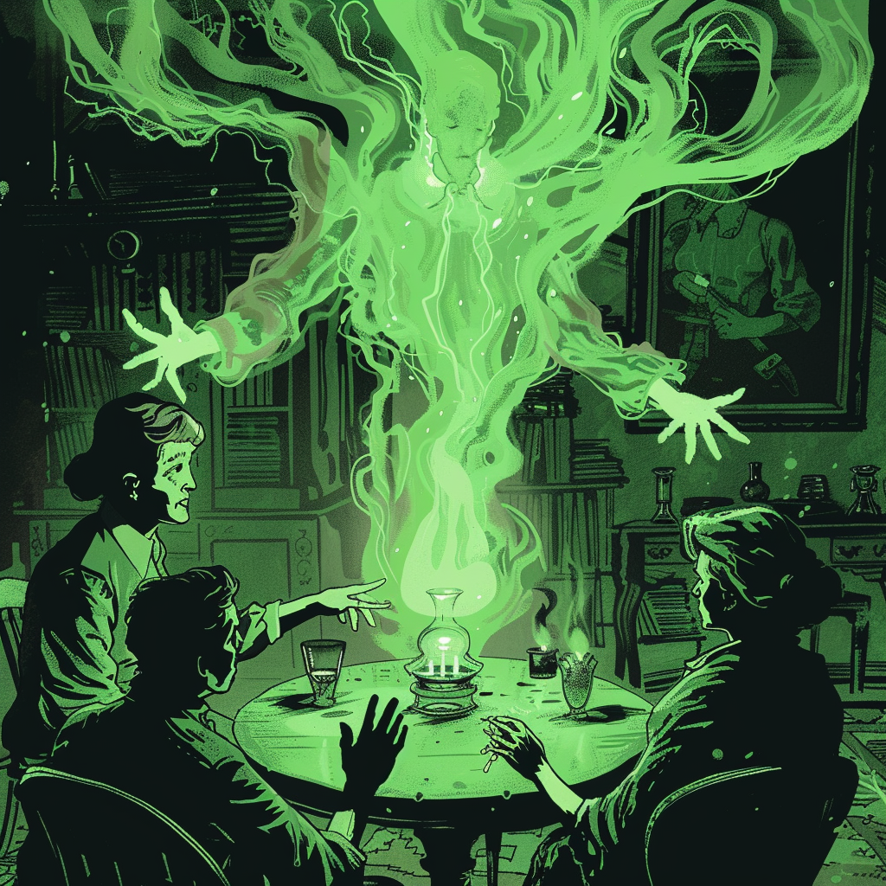
COMMUNICATION THROUGH MEDIUMS
Notes:
Communication happens through special mediums that can move between the world of the terrarium and the world of the rest of the business. I’m sure that some of you work as mediums, though you probably wouldn’t use that word.
Some of you are really good at it and communicate well with people in both worlds. But at the same time, there’s nothing you can do to prevent the fact that the communication is indirect.
I’ve also had conversations with mediums who have tried saying things to me that it’s clear that they themselves don’t understand, but that they hope that I will understand. That’s a very strange experience.

Slide 76
RESPONSE IS ERRATIC
Notes:
The response is erratic. You don’t know if you will be heard or understood, and if so, when that will happen.

Slide 77
PRAYER
Notes:
In keeping with the “communicating with the gods” metaphor, we can call it prayer.

Slide 78
EFFECTS ON RELATIONSHIPS
Notes:
What kinds of relationships can you have to people who exist in another plane?

Slide 79
COMMUNICATION
RELATIONSHIPS
Notes:
It’s hard. Communication builds relationships, relationships strengthen and enable more communication. It can be a virtuous circle. But you need to run through it regularly for this to work.

Slide 80
EFFECTS ON LEARNING
Notes:
What about learning? A basic tenet of Agile is that we don’t know everything up front and we can’t know everything up front. If we did, we should be using a different methodology. We expect to learn something important, that will alter our perspectives, our understanding of the problem we’re solving, of our strategy.

Slide 81
HOW DOES LEARNING PROPAGATE?
Notes:
So how does learning propagate in the terrarium model?

Slide 82
IT DOESN’T
Notes:
And the short answer is it doesn’t, or it does so very poorly, ineffectively, and with delay.
We already discussed how the terrarium model hinders both. This is very bad for learning.

Slide 83
WHAT DO WE EXPECT TO LEARN ABOUT?
Notes:
So what do we expect to learn about when we do software development?
We can learn effectively inside the terrarium. That means that we can learn things about implementations and technical details, and that learning doesn’t need to propagate beyond the terrarium. That’s fine.
But if we learn something important about the domain, the terrarium wall is going to be a problem. That learning should potentially influence future business decisions.

Slide 84
EFFECTS ON IMPROVEMENT
Notes:
What about continuous improvement?

Slide 85
WHAT CAN BE IMPROVED FROM WITHIN THE TERRARIUM?
Notes:
What can be improved from within the terrarium? It’s pretty obvious that people inside the terrarium are best equipped to say something about what should be improved, because it’s their lived experience.

Slide 86
ONLY THE THINGS THE TEAM CAN GET THEIR HANDS ON
Notes:
It’s tempting to answer “only things inside the terrarium”, but that’s not exactly true. There are many things about the conditions in a terrarium that’s not controllable by the creates inside the terrarium. A silk worm cannot adjust the temperature in the terrarium, or the amount of resources.

Slide 87
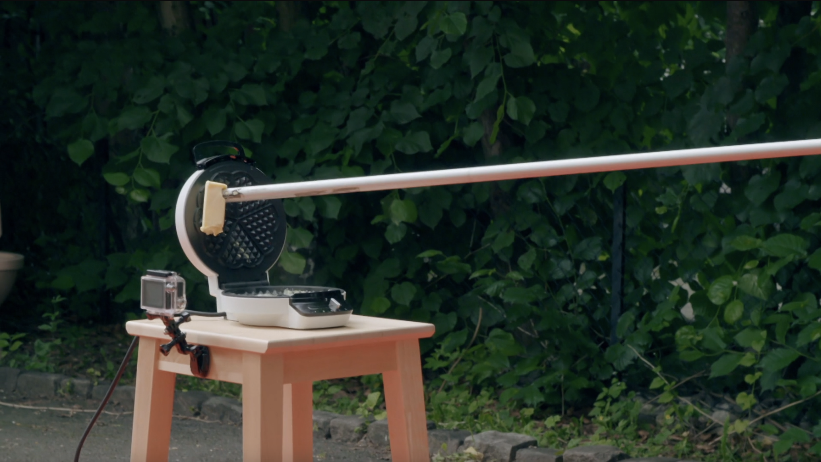
Notes:
In a sense, it’s a little bit like this, only worse. This is from a Norwegian TV show called Kongen Befaler, which is the Norwegian phrase for Simon Says. In the show, people compete in completing various ridiculous or impossible tasks. In this particular case, the task is to make a waffle. The constraint that makes the task non-trivial is that you can’t come close enough to the waffle iron to operate it. There’s a circle with a radius of a couple of meters and the contestants are not allowed to step inside that circle. This contestant is applying butter to the waffle iron by means of a long pole. It’s fairly cumbersome.
Trying to affect things that are controlled outside the terrarium is like this but much worse because you can’t even see them. You don’t know what they look like or where they are. You don’t know how they’re operated. You can’t even be completely sure they exist. Remember that they exist on another plane.

Slide 88
FOR THINGS CONTROLLED OUTSIDE THE TERRARIUM TEAMS MUST RELY ON PRAYER
Notes:
So for things controlled outside the terrarium, teams must rely on prayer.

Slide 89
RESPONSE IS ERRATIC
Notes:
And again, response to prayer can be erratic. A consequence might be that you give up on praying.

Slide 90
CHANCES ARE ONLY THINGS THE TEAM CAN AFFECT DIRECTLY WILL BE IMPROVED

Slide 91
IMPORTANT THINGS
THINGS THE TEAM CAN INFLUENCE

Slide 92
EFFECTS ON CHANGE
Notes:
What about change? When I say change, I mean the changes that we apply in response to learning.

Slide 93
WHAT CAN CHANGE?
Notes:
What can change in such an arrangement? What can be adapted to new circumstances?

Slide 94
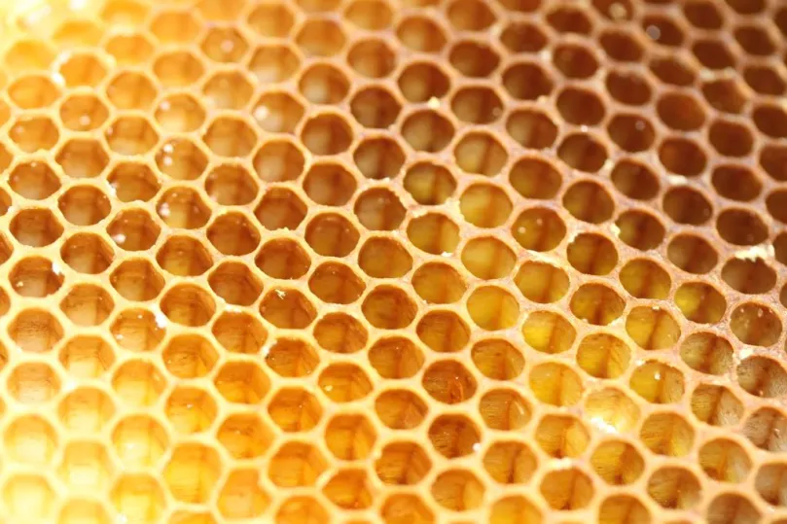
HOW AGILE CAN YOU BEE IN A BOX?
Notes:
Well I don’t know. How Agile can you be in a box? (Look, we scaled Agile.)
Things inside the box can change, if you can get your hands on the right levers. What about the boxes themselves?
What if you have multiple boxes?

Slide 95
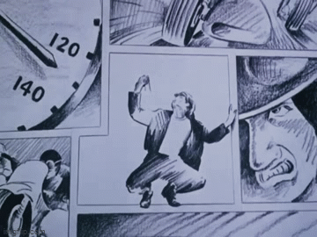
Notes:
This here is the mental image I have of an Agile team inside its box. If the boxes themselves are rigid, change is going to be limited. So how Agile is your organization going to be?

Slide 96
IS THE TERRARIUM AS GOOD AS IT GETS?
Notes:
This brings us back to this question.

Slide 97
THE TERRARIUM IS AT ODDS WITH AGILE PRINCIPLES
Notes:
I think it’s reasonable to say that the terrarium model, whether we like it or not, is fundamentally incompatible with some Agile ideals.

Slide 98
CROSSROADS
Notes:
Which places us at a crossroads I think. We have a bit of a Matrix moment here. What do we want to do?

Slide 99
HOW TO DEAL WITH THE GAP BETWEEN NARRATIVE AND REALITY?
Notes:
How should we deal with the gap between narrative and reality?

Slide 100
FIX REALITY
Notes:
I think we have three choices. Either we fix reality so that it aligns better with our ideals. That means the terrarium model has to go, and we need to do things differently. This is answering “no” to the question ”is the terrarium as good as it gets?”

Slide 101
DOWNSCALE THE NARRATIVE
Notes:
A different solution would be to downscale the narrative, reduce our ambitions, abandon some of our ideals, and basically embrace the terrarium. This is answering “yes”.

Slide 102
DO NOTHING
Notes:
And finally, the third option is to do nothing. We pretend there is no problem. We keep the gap. We tell ourselves one thing and do something else.
I think hypocrisy is the technical term for this. This is refusing to answer the question, or even acknowledging that the question is valid.

Slide 103
BEYOND THE TERRARIUM
Notes:
What if we are romantics, optimists? If we want to try to move beyond the terrarium, what should we do?

Slide 104
HOSTILE ENVIRONMENT
Notes:
The first thing to do is to consider this hostile environment that the terrarium is supposed to protect against.
Maybe it’s not so hostile anymore? Maybe it isn’t the toxic cesspool that we make it out to be?
I don’t know. I just pitted myself as an optimist, but I’m not sure. If it was toxic before, why wouldn’t it be toxic now?
Businesses have learned quite a bit about the realities of software development over the past 20 years.
At the same time, if there’s one thing that we know will be constant, it’s our human traits, including our vices.

Slide 105
GROW MORE RESILIENT
Notes:
Either you grow more resilient. You learn to live in a hostile environment.

Slide 106
IMPROVE THE ENVIRONMENT
Notes:
You could try to improve the environment.

Slide 107
DIE
Notes:
Rather defeatist

Slide 108
BREAK AND HOPE?
Notes:
So should we just break the terrarium and hope that the team survives?

Slide 109
WAIT AND BREAK?
Notes:
Or should we wait until we have managed to de-toxify the environment and then break the terrarium?
That might take a long time. Maybe we’ll never make it. How do know it its safe enough now?

Slide 110
THE BLACK HOLE APPROACH
Notes:
I have higher hopes for what I think of as the black hole approach. Which is to say, we turn the terrarium into a black hole that sucks into itself whatever it needs from the environment

Slide 111
ASSIMILATE EVERYTHING THE TEAM NEEDS TO BE SELF-SUFFICIENT
Notes:
That works both as one and two sentences.

Slide 112
TURN TERRARIUMS INTO ORGANIZATIONS
Notes:
So basically we turn the terrariums into small organizations in their own right, rather than absorb the terrarium in the larger organization.

Slide 113
LARGER ORGANIZATION AS ALLIANCE OF SMALLER ORGANIZATIONS
Notes:
We should think of the larger organization as a loosely coupled alliance of smaller organizations.

Slide 114
MOVE NON-TECHIES INSIDE
Notes:
You need non-technies inside.

Slide 115
MOVE DECISIONS INSIDE
Notes:
You need to put the important decisions inside, not just the trivial ones.

Slide 116
MOVE OWNERSHIP INSIDE
Notes:
We move ownership of the problem inside.

Slide 117
MOVE THE MONEY INSIDE
Notes:
You need to move the money inside the team. Give the team a budget.

Slide 118
DIRECT COMMUNICATION WITH STAKEHOLDERS
Notes:
You need direct communication with stakeholders.

Slide 119
DIRECT COMMUNICATION WITH USERS / CUSTOMERS
Notes:
You need direct communication with users or customers. But the team does this now. They don’t ask anyone. It’s their users, their customers.

Slide 120
WITHOUT DIRECT COMMUNICATION FEEDBACK IS A BLUFF

Slide 121
CAN WE DO THIS?

Slide 122
DO WE WANT TO?

Slide 123
DO YOU?

